Slide 1
Chapter 3: Fundamental Spatial Concepts

Slide 2
Learning outcomes
manipulate Euclidean geometry, in which distances, angles, and coordinates may be defined;
understand topology, and its construction from the basic concept of a neighborhood;
construct simple representations of space using sets and graphs; and
appreciate how a metric space formalizes the concept of distance between points in space.

Slide 3
Geometry and invariance
Geometry: provides a formal representation of the abstract properties and structures within a space, founded on the idea of invariance
Invariance: a group of transformations of space under which propositions remain true, for example
distance is invariant under translations and rotations but not scalings
angle and parallelism are invariant under translations, rotations, and scalings

Slide 4
Section 3.1
Euclidean space

Slide 5
Euclidean space
Spatial phenomena are most commonly modeled as embedded in a physical 2- or 3D space, called Euclidean space
The 2D Euclidean plane consists of a coordinate frame with
a fixed, distinguished point (origin)
a pair of orthogonal lines (axes) intersecting in the origin
This coordinatized Euclidean plane transforms spatial properties into properties of tuples of real numbers and is known as the Cartesian plane

Slide 6
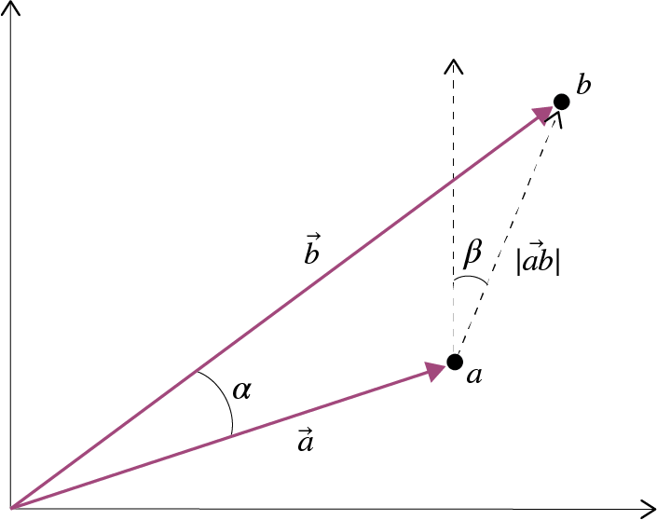
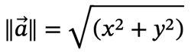
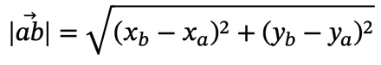
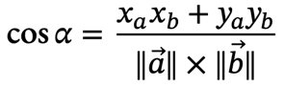
Points
A point in the Cartesian plane is associated with a unique pair of real number a = (x, y) measuring distance from the origin in the x and y directions. It is sometimes convenient to think of the point a as a vector.
Scalar: Addition, subtraction, and multiplication
Norm:
Distance:
Angle between vectors:

Slide 7
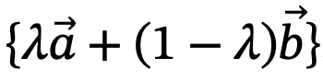
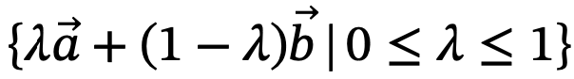
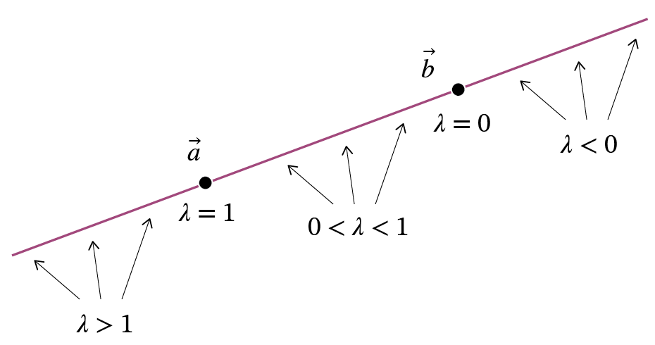
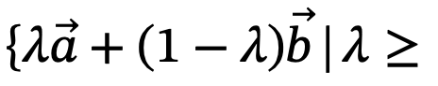
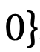
Lines
The line incident with a and b is defined as the point set:
The line segment between a and b is defined as the point set:
The half line radiating from b and passing through a is defined as the point set:

Slide 8
Polygons
A polyline in Cartesian space is a finite set of line segments (called edges) such that each edge end-point is shared by exactly two edges, except possibly for two points, called the extremes of the polyline.
If no two edges intersect at any place other than possibly at their end-points, the polyline is simple.
A polyline is closed if it has no extreme points.
A (simple) polygon in R2 is the area enclosed by a simple closed polyline. This polyline forms the boundary of the polygon. Each end-point of an edge of the polyline is called a vertex of the polygon.
A convex polygon has every point intervisible
A star-shaped or semi-convex polygon has at least one point that is intervisible

Slide 9
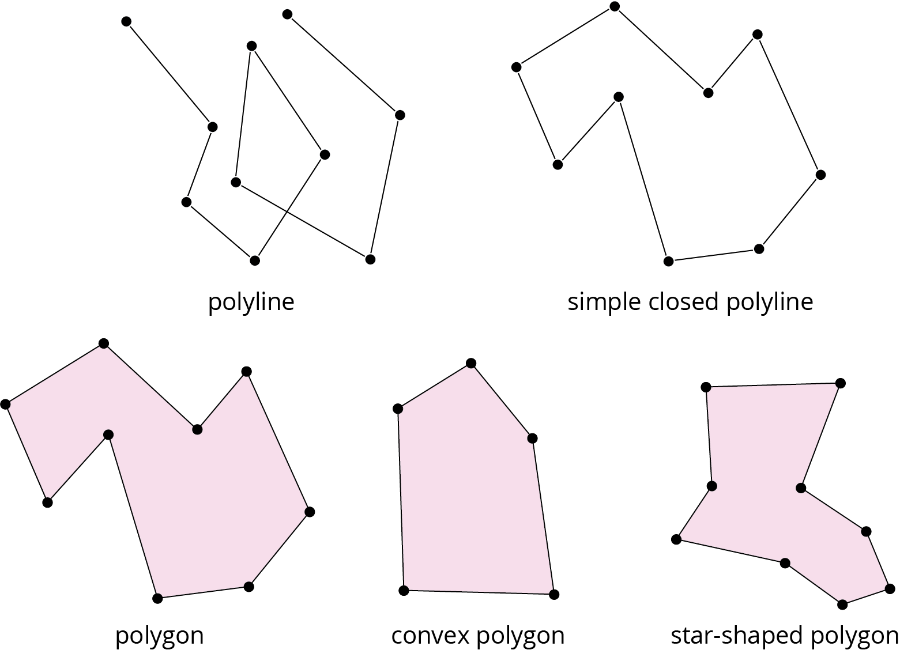
Polygons

Slide 10
Polygons
Monotone chain: there is some line in the Euclidean plane such that the projection of the vertices onto the line preserves the ordering of the list of points in the chain
Monotone polygon: if the boundary can be split into two polylines, such that the chain of vertices of each polyline is a monotone chain
Triangulation: partitioning of the polygon into triangles that intersect only at their mutual boundaries

Slide 11
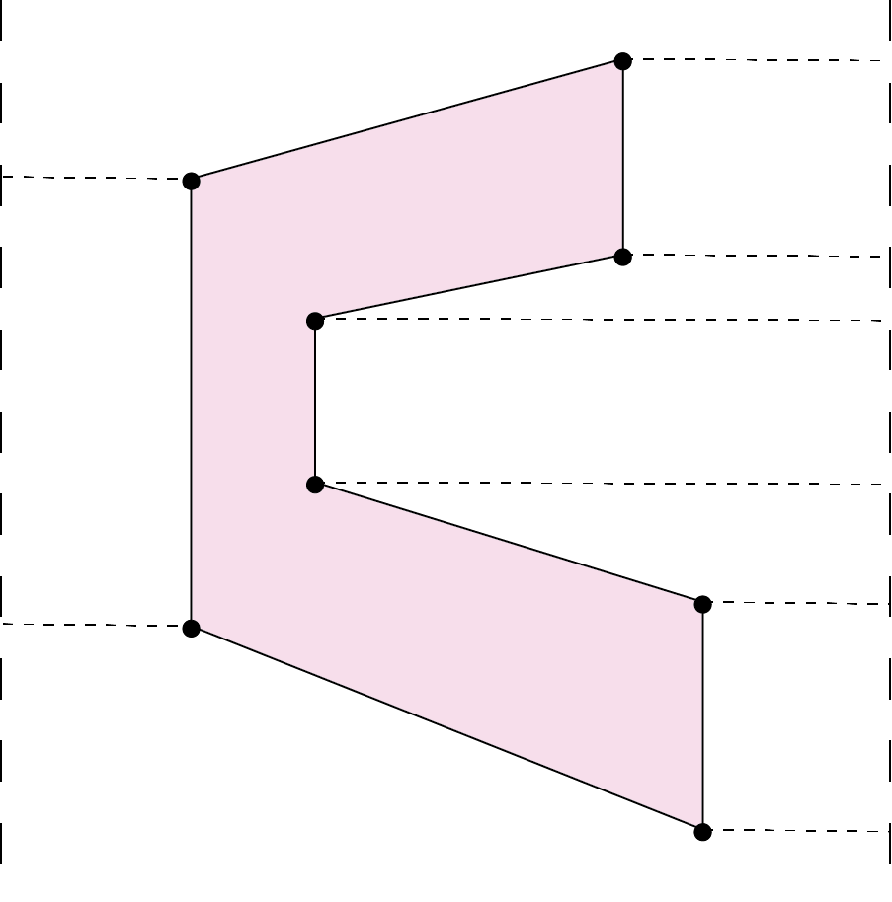
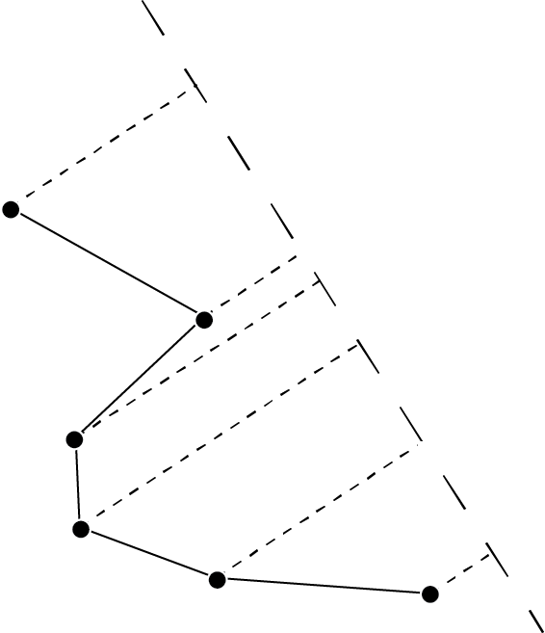
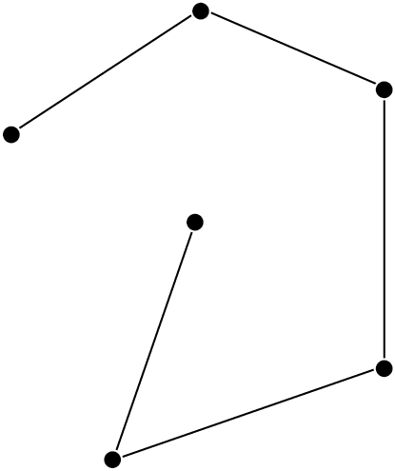
Polygons
monotone
non monotone
monotone polygon

Slide 12
Transformations
Transformations preserve particular properties of embedded objects
Euclidean transformations preserve shape and size, e.g., translations
Similarity transformations preserve shape but not necessarily size, e.g., scalings
Affine transformations preserve affine properties, such as parallelism, e.g., rotations
Projective transformations preserve projective properties (intuitively properties that are preserved when projecting a shape onto a screen)
Topological transformation preserve topological properties, discussed in a later section

Slide 13
Section 3.2
Set-based spaces

Slide 14

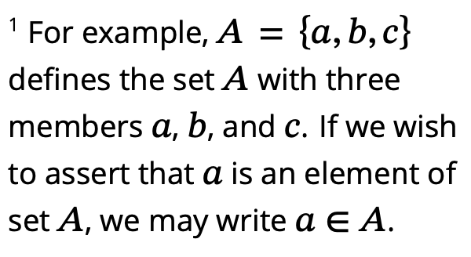
Sets
The set based model involves:
The constituent objects to be modeled, called elements or members
Collection of elements, called sets
The relationship between the elements and the sets to which they belong, termed membership

Slide 15
Sets
Equality: a relationship between two sets that holds when the sets contain precisely the same members
Subset: the relationship between two sets where every member of one set is a member of the second
Power set: the set of all subsets of a set
Partition: a set of subsets of a set, such that each and every member of the original set appears in exactly one subset in the partition
Empty set: the set containing no members
Cardinality: the number of members in a set
Intersection: a binary operation that takes two sets and returns the set of elements that are members of both the original sets
Union: a binary operation that takes two sets and returns the set of elements that are members of at least one of the original sets
Difference: a binary operation that takes two sets and returns the set of elements that are members of the first set but not the second set
Complement: a unary operation that when applied to a set returns the set of elements that are not in the set

Slide 16
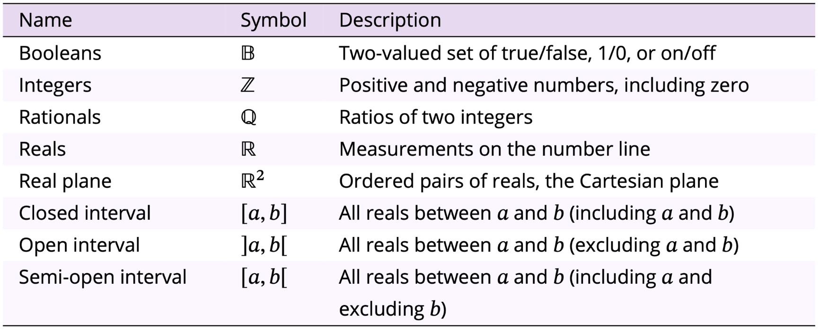
Distinguished sets

Slide 17
Relations
Product: returns the set of ordered pairs, whose first element is a member of the first set and second element is a member of the second set
Binary relation: a subset of the product of two sets, whose ordered pairs show the relationships between members of the first set and members of the second set
Reflexive relations: where every element of the set is related to itself
Symmetric relations: where if x is related to y then y is related to x
Transitive relations: where if x is related to y and y is related to z then x is related to z
Equivalence relation: a binary relation that is reflexive, symmetric and transitive

Slide 18
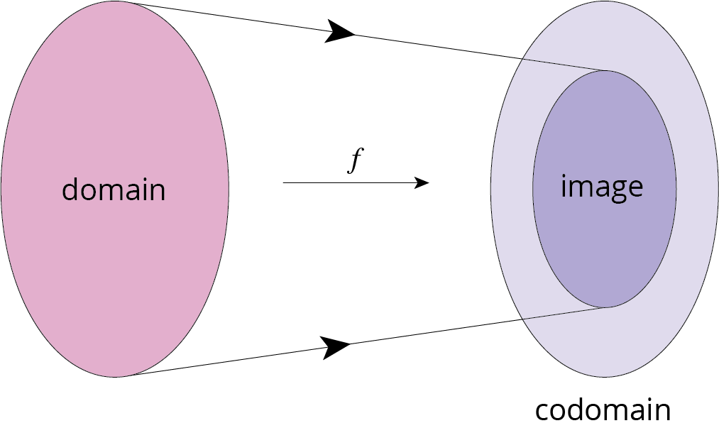
Functions
Function: a type of relation which has the property that each member of the first set relates to exactly one member of the second set

Slide 19
Functions
Injection: any two different points in the domain are transformed to two distinct points in the codomain
Image: the set of all possible outputs
Surjection: when the image equals the codomain
Bijection: a function that is both a surjection and an injection

Slide 20
Convexity
A set is convex if every point is visible from every other point within the set
Let S be a set of points in the Euclidean plane
Point x in S is visible from point y in S if either x = y or it is possible to draw a straight-line segment between x and y that consists entirely of points of S
The point x in S is an observation point for S if every point of S is visible from x
The set S is semi-convex (star-shaped if S is a polygonal region) if there is some observation point for S
The set S is convex if every point of S is an observation point for S

Slide 21
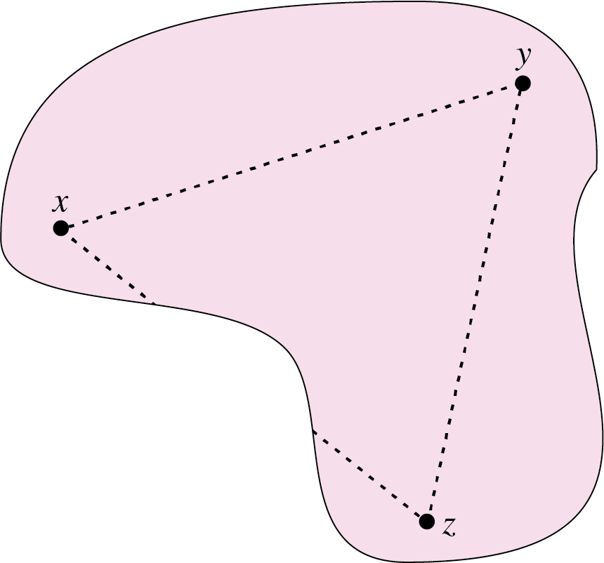
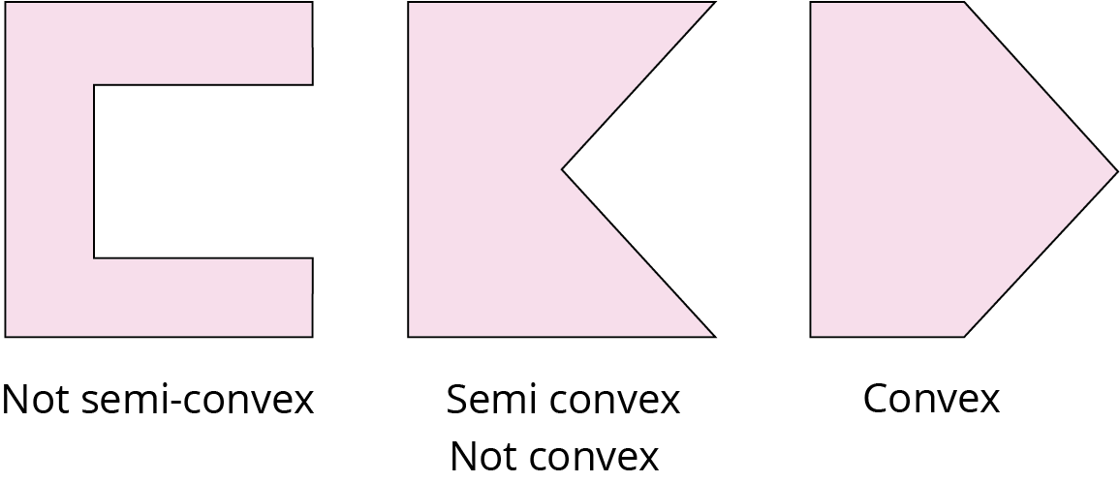
Convexity
visibility

Slide 22
Section 3.3
Topology of space

Slide 23
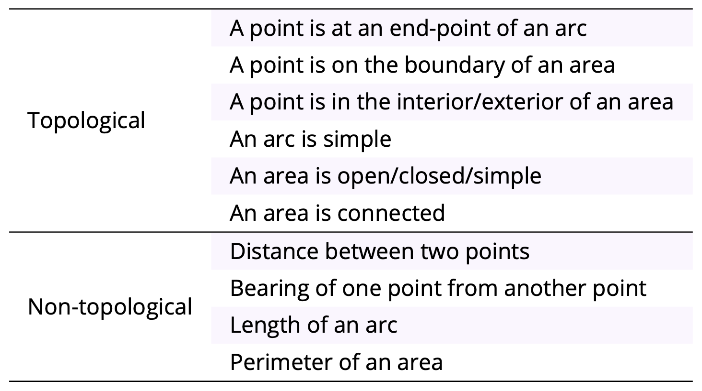
Topology
Topology is the “study of form” and concerns properties that are invariant under topological transformations
Intuitively, topological transformations are rubber sheet transformations

Slide 24
Point set topology
One way of defining a topological space is with the idea of a neighborhood
Let S be a given set of points. A topological space is a collection of subsets of S, called “neighborhoods,” that satisfy the following two conditions:
T1 Every point in S is in some neighborhood.
T2 The intersection of any two neighborhoods of any point x in S contains a neighborhood of x
Points in the Cartesian plane and open disks (circles surrounding the points) form a topology

Slide 25
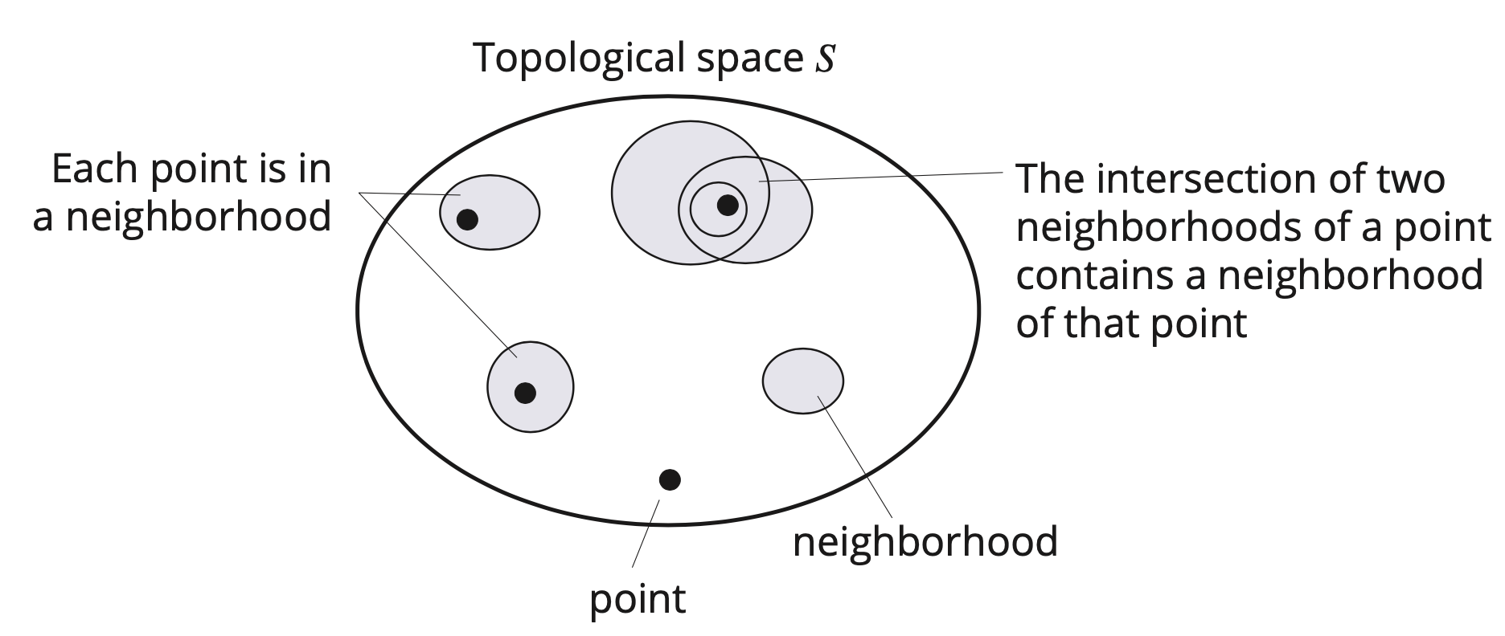
Point set topology

Slide 26
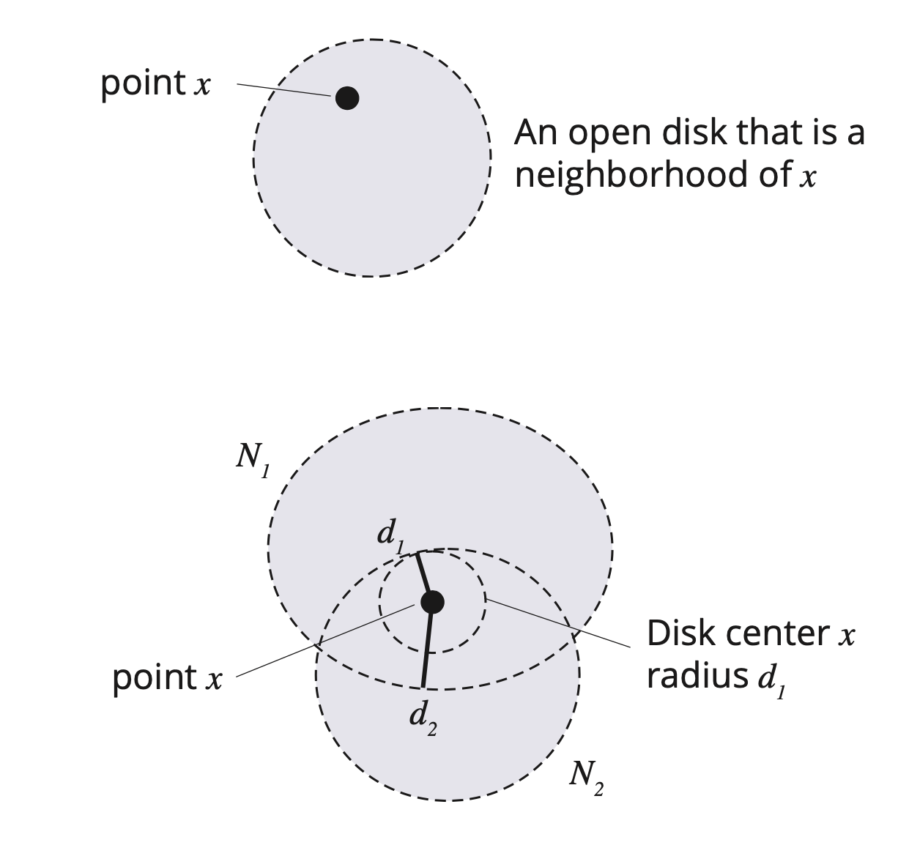
The usual topology
The usual topology is that topology which naturally comes to mind with the Euclidean plane and corresponds to the rubber-sheet topology

Slide 27
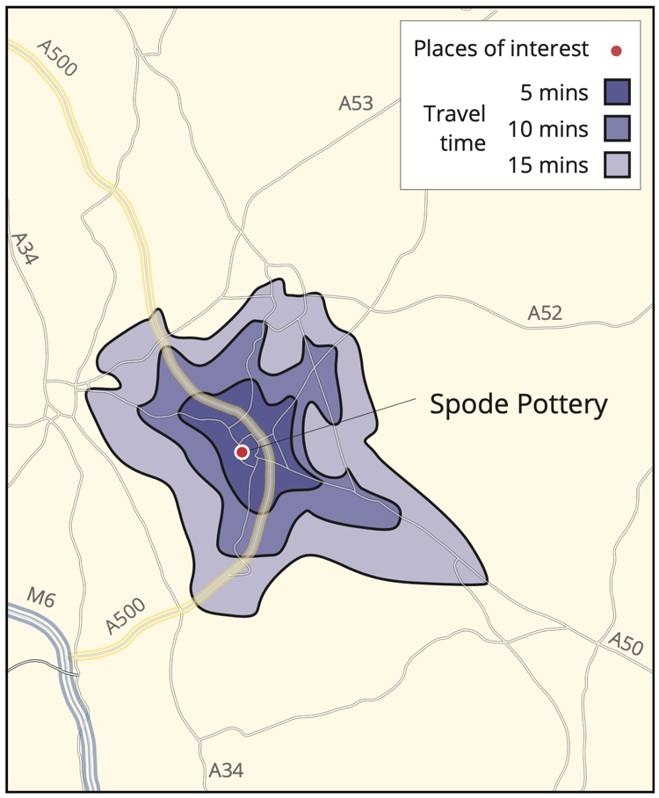
Travel time topology
Let the neighborhoods be all t-zones around a point
Then T1 and T2 are satisfied

Slide 28
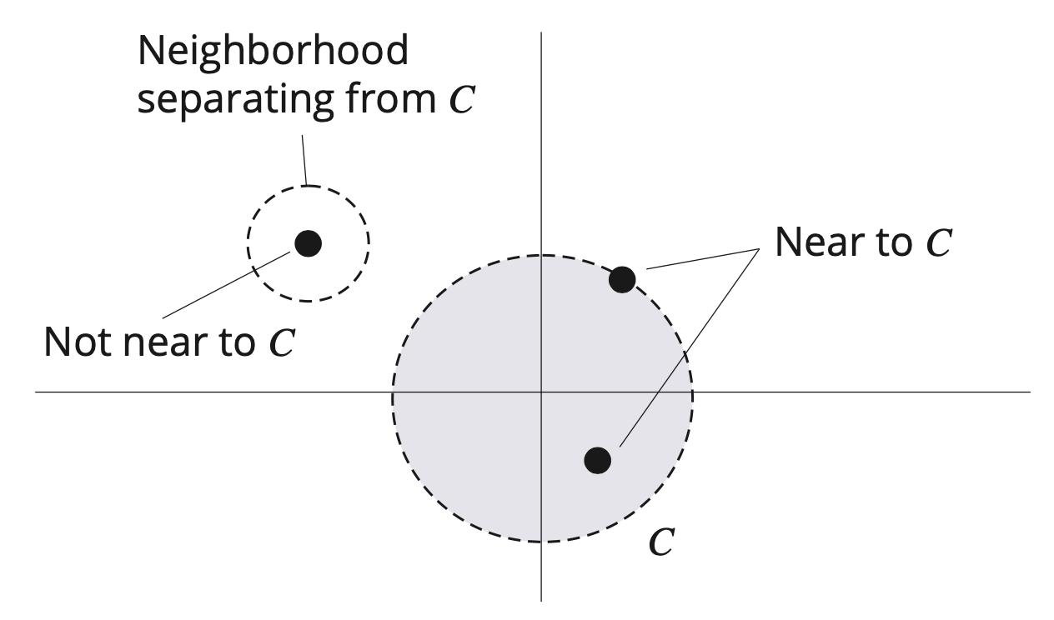
Nearness
Let S be a topological space. Then S has a set of neighborhoods associated with it
Let C be a subset of points in S and c an individual point in S
Define c to be near C if every neighborhood of c contains some point of C

Slide 29
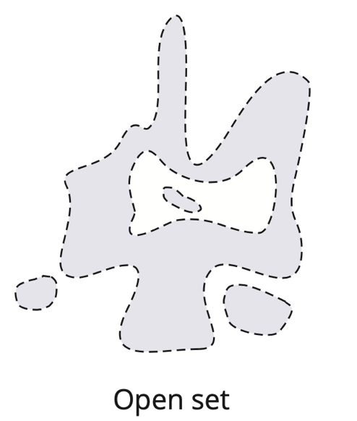
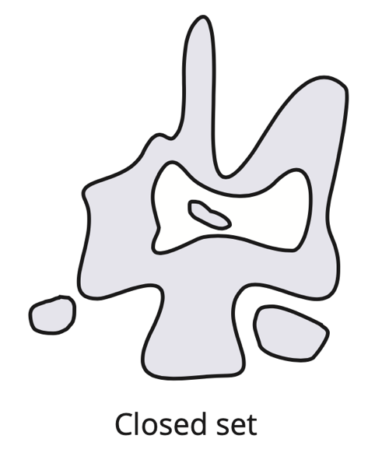
Open and closed sets
Let S be a topological space and X be a subset of points of S.
Then X is open if every point of X can be surrounded by a neighborhood that is entirely within X
i.e., a set that does not contain its boundary
Then X is closed if it contains all its near points
i.e., set that does contain its boundary

Slide 30
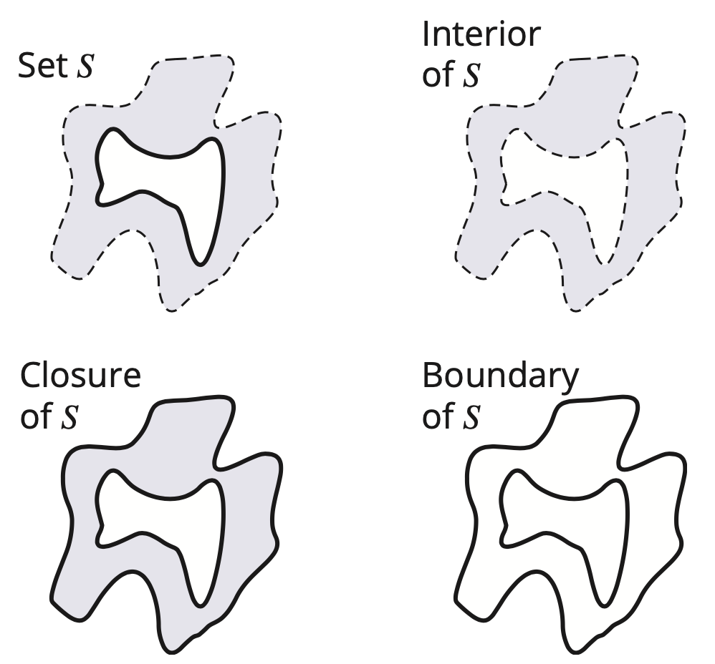
Closure, boundary, interior
Let S be a topological space and X be a subset of points of S
The closure of X is the union of X with the set of all its near points
The interior of X consists of all points which belong to X and are not near points of the complement of X
The boundary of X consists of all points which are near to both X and the complement of X.

Slide 31
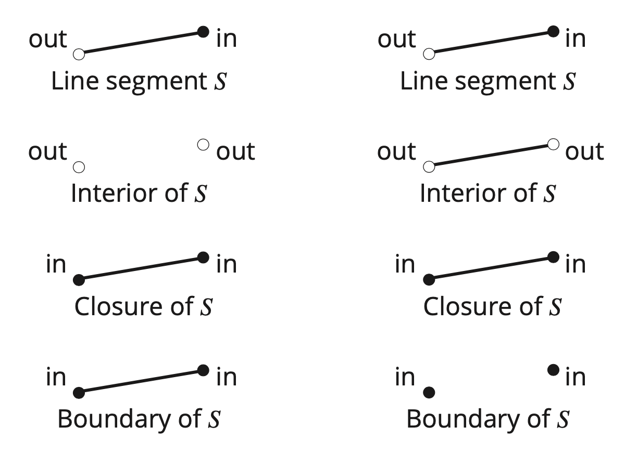
Topology and embedding space
2-space
1-space

Slide 32
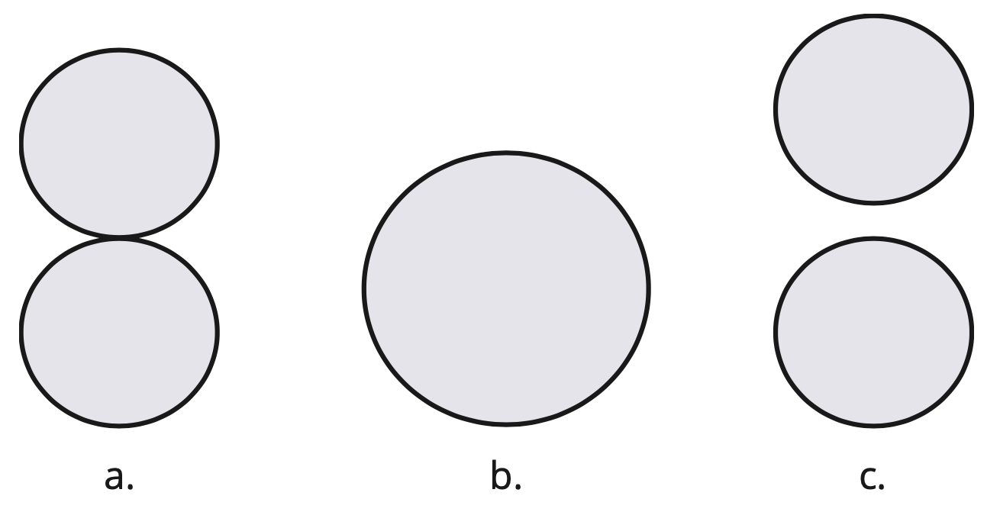
Connectedness I
Let S be a topological space and X be a subset of points of S
Then X is connected if whenever it is partitioned into two non-empty disjoint subsets, A and B
either A contains a point near B, or B contains a point near A, or both

Slide 33
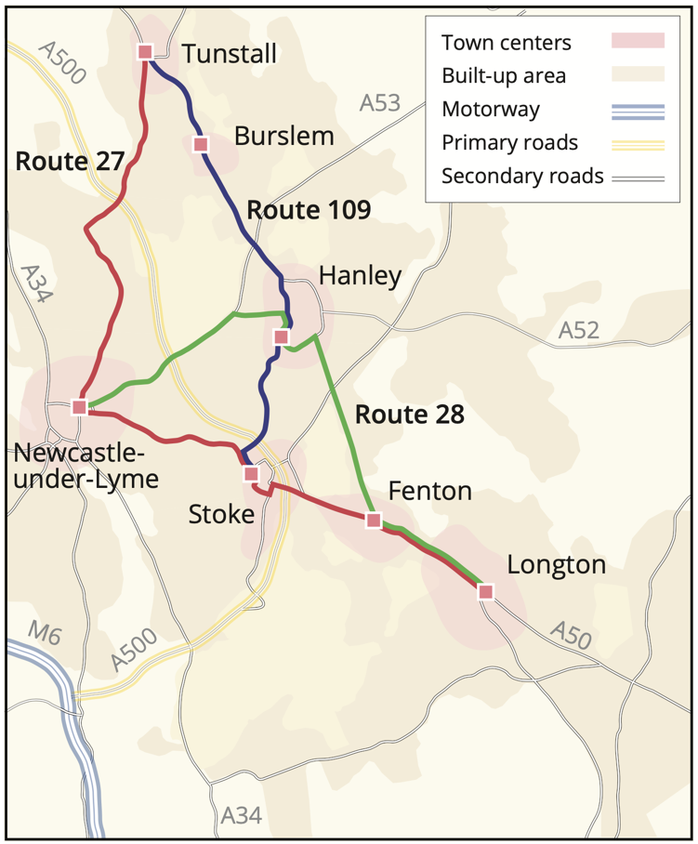
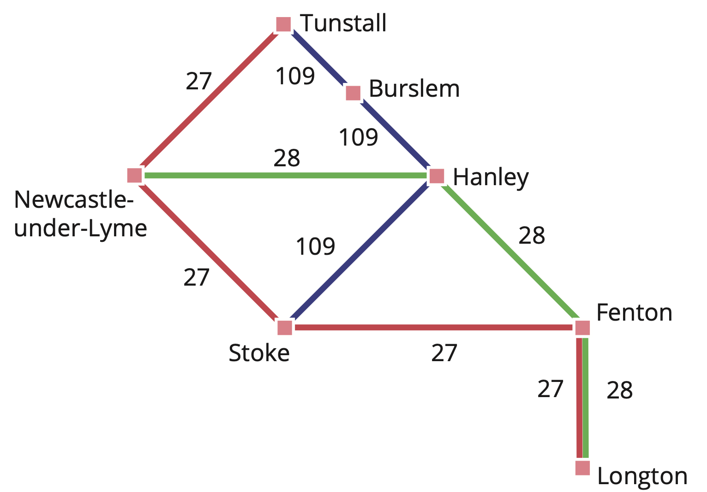
Topological invariants
Properties that are preserved by topological transformations are called topological invariants

Slide 34
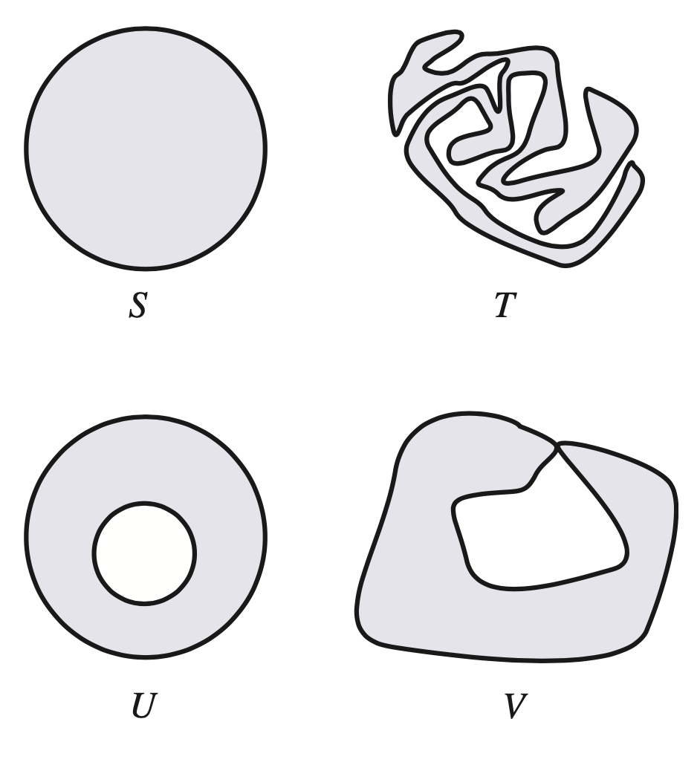
Topological equivalents
Sets in the plane that can be transformed into one another while maintaining topological invariants are termed topological equivalents
Sets S and T are topologically equivalent
Sets U and V are not topologically equivalent to any other shown

Slide 35
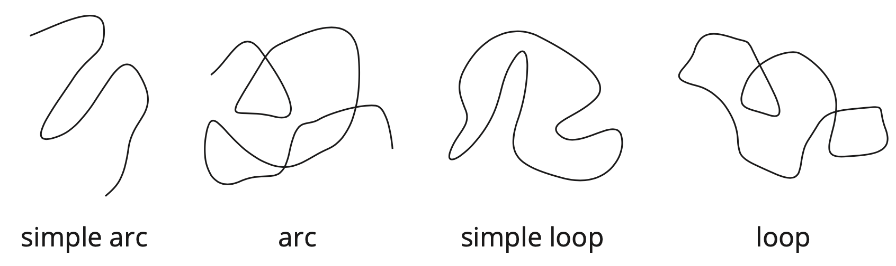
Classifying 1D objects topologically
Examples below show some 1D planar objects that are all mutually topologically not equivalent

Slide 36
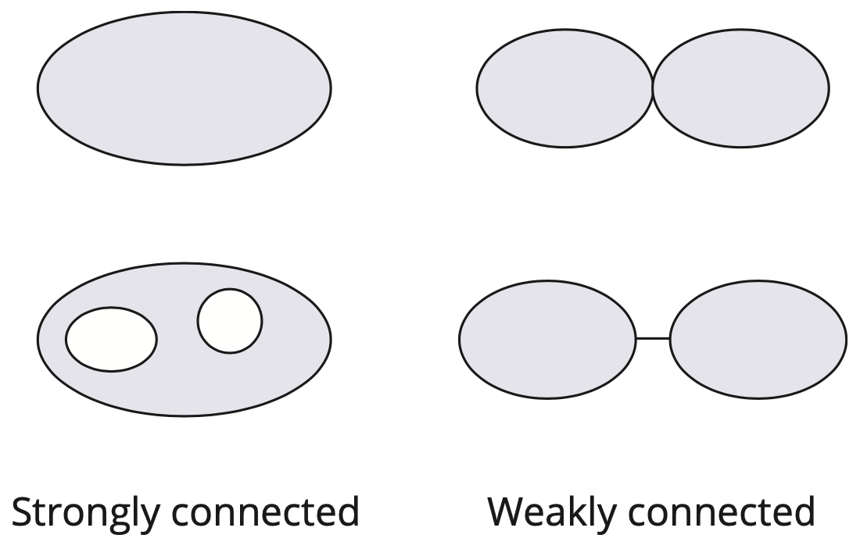
Connectedness II
A set in a topological space is path-connected if any two points in the set can be joined by a path that lies wholly in the set
A set X in the Euclidean plane with the usual topology is weakly connected if it is possible to transform X into an unconnected set by the removal of a finite number of points
A (path) connected set X in the Euclidean plane with the usual topology is strongly connected if it is not weakly connected

Slide 37
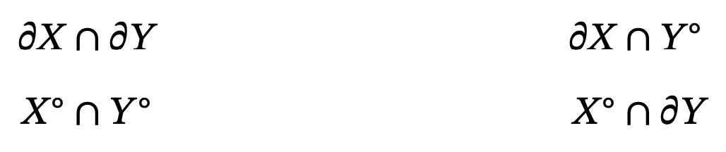
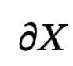
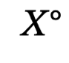
4-intersection model (4IM)
The 4-intersection model (4IM) is an important characterization of the topological relationships between spatial objects based on the point-set topology notions of boundary and interior
The 4IM considers the following four sets:
Notation
Boundary of X is:
Interior of X is:

Slide 38
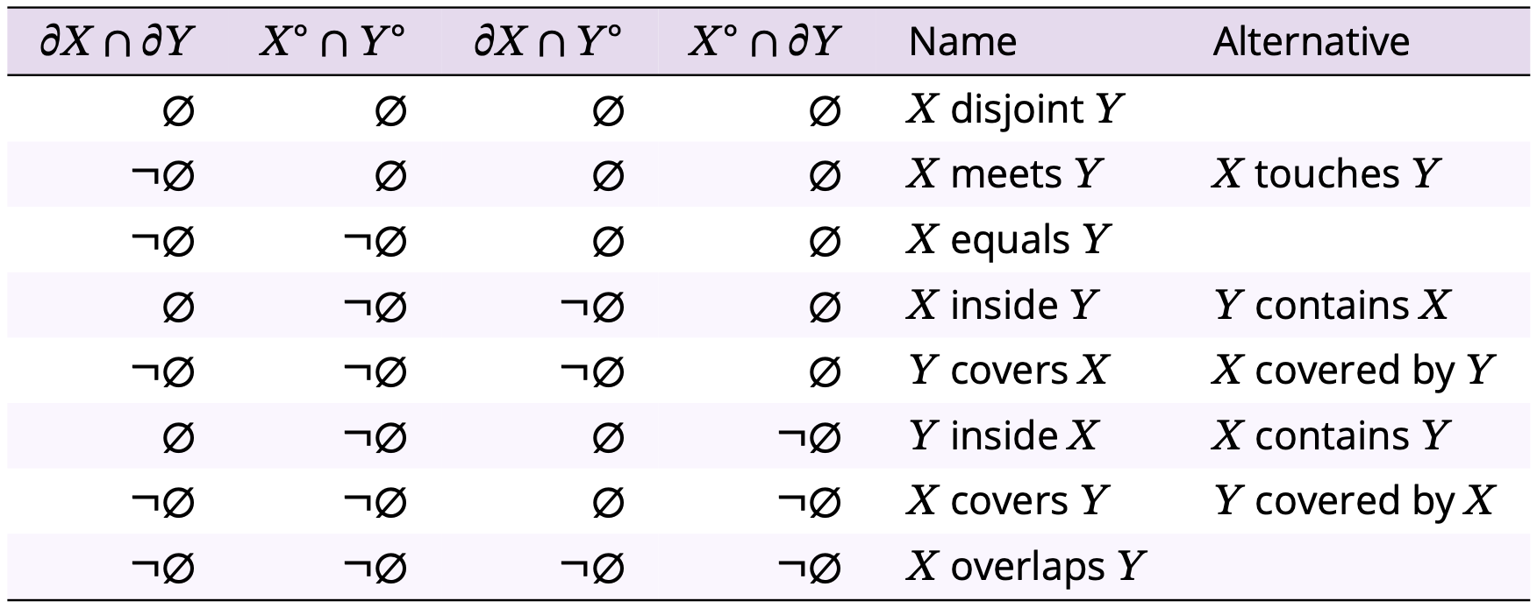
4-intersection model (4IM)
Each of point sets may either be empty (written ∅, the empty set) or non-empty (¬∅)
In the Euclidean plane, only eight of 4 × 4 = 16 different mutually exclusive combinations can occur

Slide 39
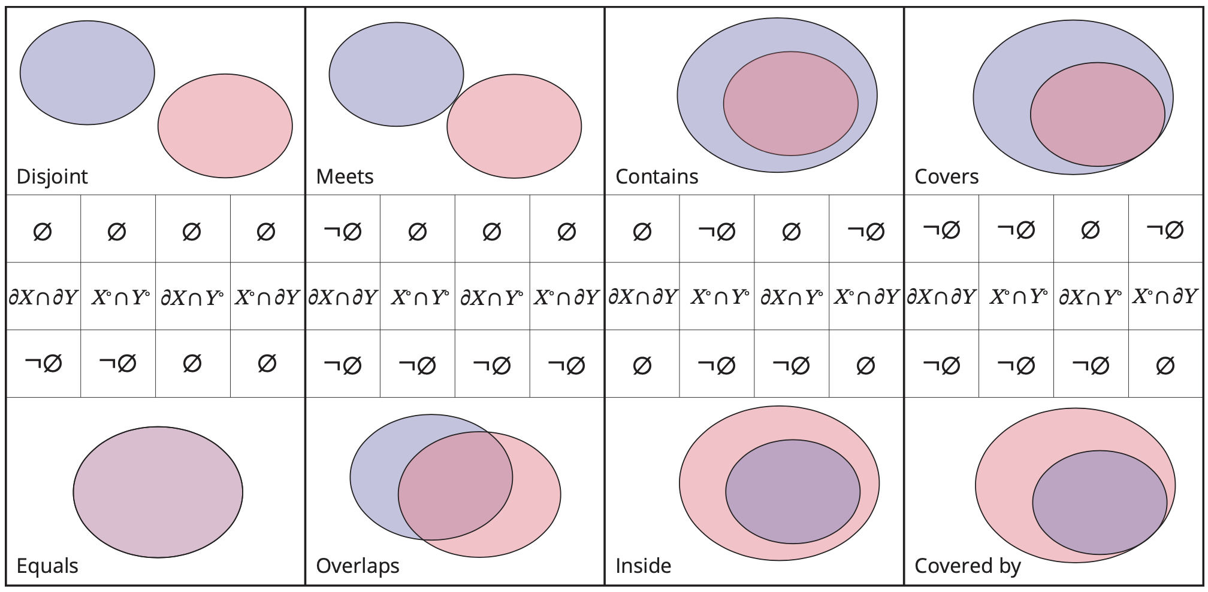
4-intersection model (4IM)

Slide 40
Combinatorial topology
Euler’s formula: Given a polyhedron with f faces, e edges, and v vertices, then: f – e + v = 2
Remove a single face from a polyhedron and apply a 3-space topological transformation to flatten the shape onto the plane
Given a cellular arrangement in the plane, with f cells, e edges, and v vertices, f – e + v = 1
The result of f – e + v is called the Euler characteristic of a surface.

Slide 41
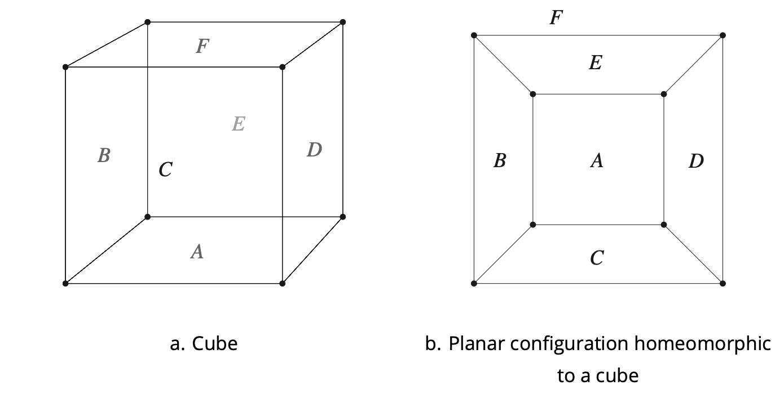
Combinatorial topology

Slide 42
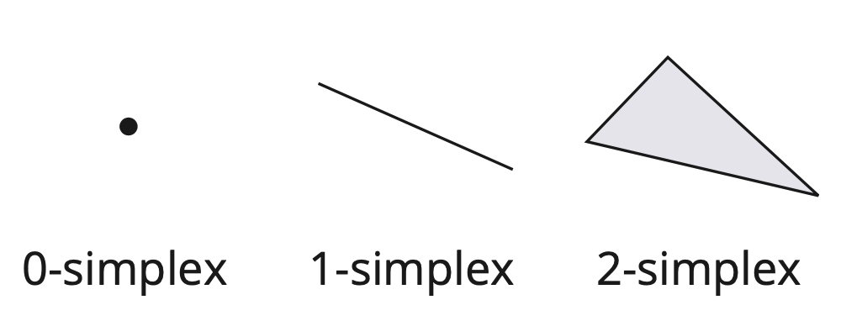
Simplexes and complexes
0-simplex: a set consisting of a single point in the Euclidean plane
1-simplex: a closed finite straight-line segment
2-simplex: a set consisting of all the points on the boundary and in the interior of a triangle whose vertices are not collinear

Slide 43
Simplexes and complexes
Simplicial complex: simple triangular network structures in the Euclidean plane (two-dimensional case)
A face of a simplex S is a simplex whose vertices form a proper subset of the vertices of S
A simplicial complex C is a finite set of simplexes satisfying the properties:
A face of a simplex in C is also in C
The intersection of two simplexes in C is either empty or is also in C

Slide 44
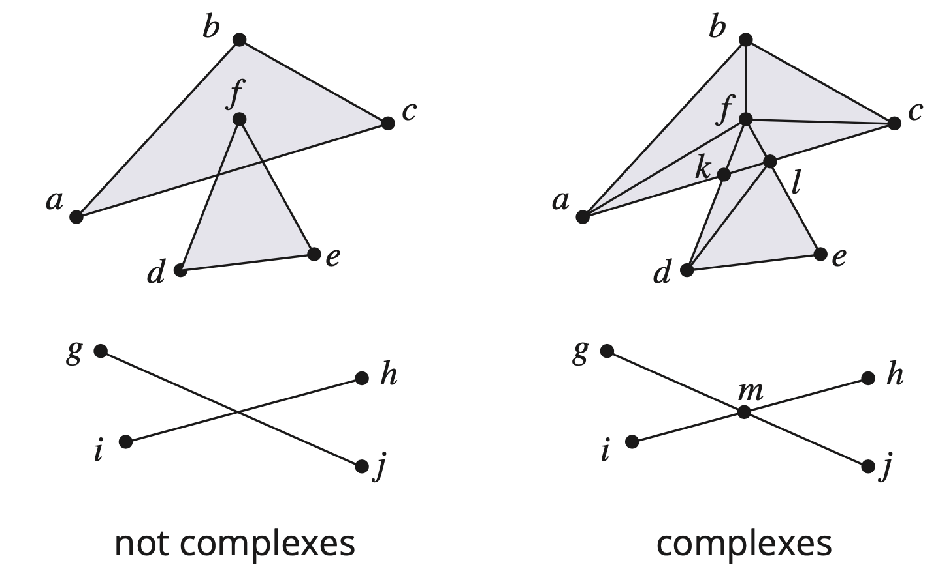
Simplexes and complexes

Slide 45
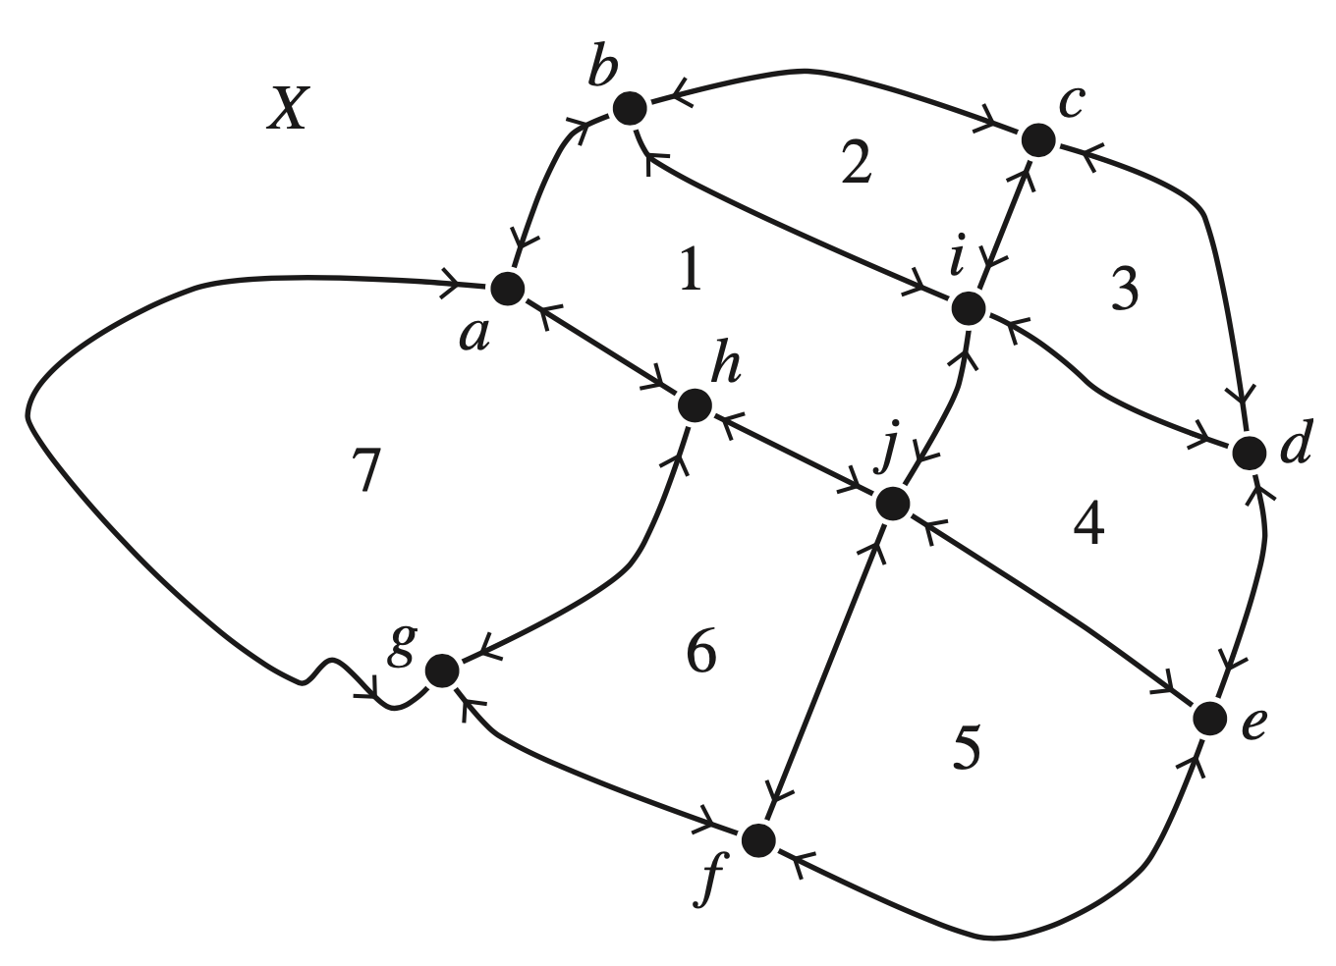
Combinatorial map
Assume that the boundary of a cellular arrangement is decomposed into simple arcs and nodes that form a network
Give directions to each arc so that traveling along the arc the object bounded by the arc is to the right of the directed arc
The combinatorial map provides a unique and unambiguous representation of a cellular arrangement

Slide 46
Section 3.4
Further spaces

Slide 47
Abstract graphs revisited (see Chapter 2)
An undirected graph 𝐺=(𝑁,𝐸) is a set of nodes 𝑁 together with a set 𝐸 of unordered pairs of nodes, called edges
A directed graph 𝐺=(𝑁,𝐸) is a set of nodes 𝑁 together with a set of edges drawn from a relation on the set of nodes, 𝐸 ⊆ 𝑁 × 𝑁
An (edge) labeled graph 𝐺=(𝑁,𝐸,𝑤) is a set of nodes 𝑁, edges 𝐸, together with an edge-labeling function 𝑤 ∶ 𝐸 → 𝐿 mapping each edge to a label in the set 𝐿
An (edge) weighted graph is a labeled graph 𝐺=(𝑁,𝐸,𝑤) where the labels are drawn from positive numbers
A (directed) multigraph 𝐺 = (𝑁,𝐸,𝑠,𝑡) is a set of nodes 𝑁, a set of edges 𝐸, and two functions 𝑠 ∶ 𝐸 → 𝑁 and 𝑡 ∶ 𝐸 → 𝑁 mapping each edge to its start and end node, respectively

Slide 48
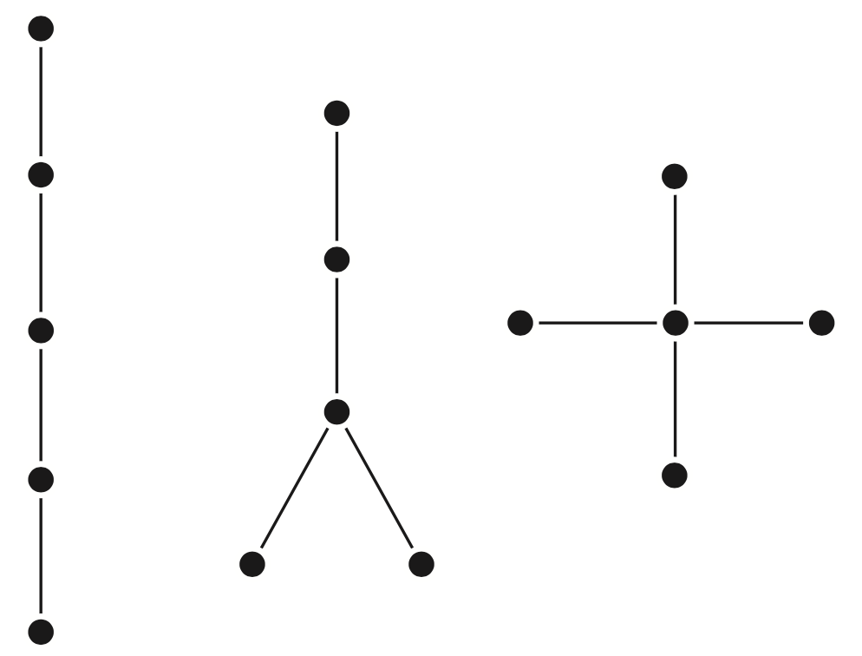
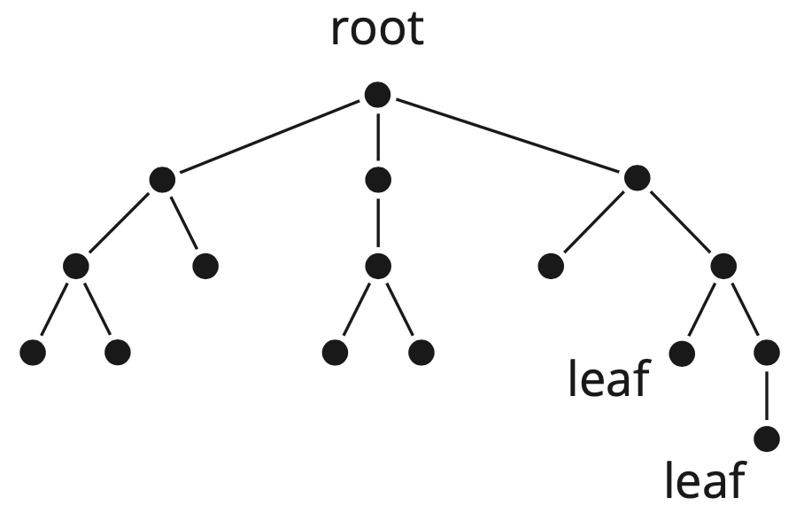
Trees and DAGs
A tree is a connected acyclic graph
A rooted tree is a tree that has one of its nodes, the root, distinguished from the others
A directed acyclic graph (DAG) is a connected, directed graph with no cycles. A DAG defines a partial order on its nodes.

Slide 49
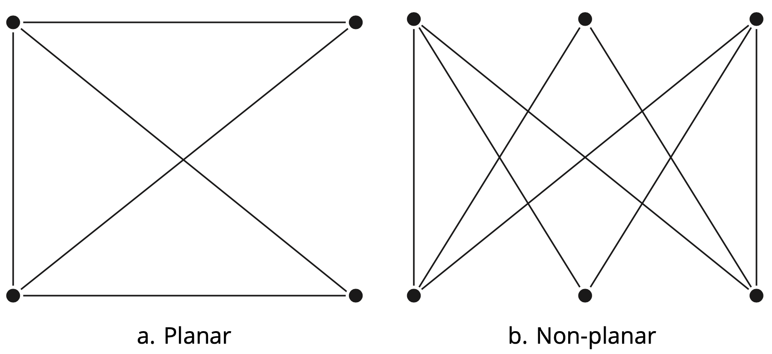
Planar graphs
A planar graph can be embedded in the plane in a way that preserves its structure
In particular, planar graph edges are embedded as arcs that may only intersect at nodes of the graph

Slide 50
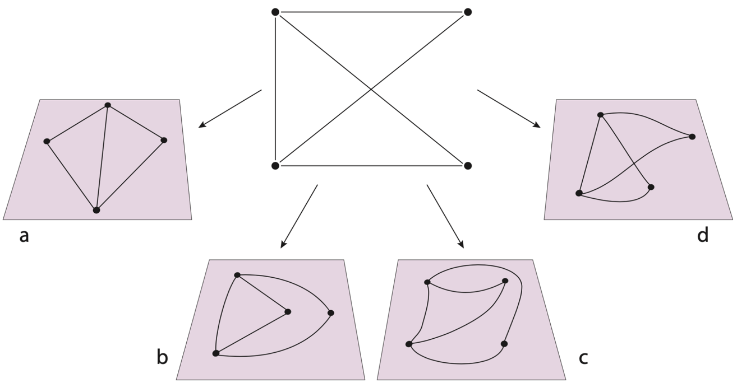
Planar graph embeddings
There are many topologically inequivalent planar embeddings of a planar graph in the plane

Slide 51
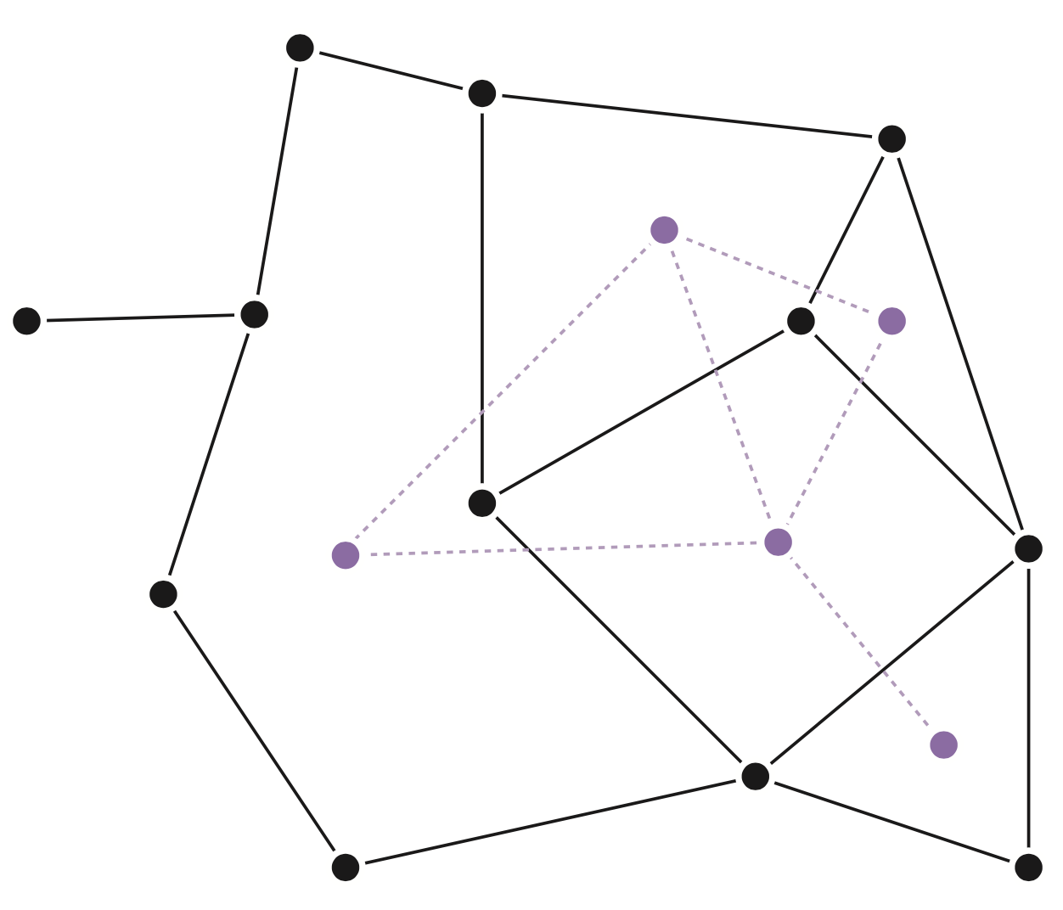
Dual of a planar graph
The dual G* is obtained from a planar graph G and its planar embedding by:
associating a node in G* with each face in G
two nodes in G* are connected by an edge if and only if their corresponding faces in G are adjacent

Slide 52
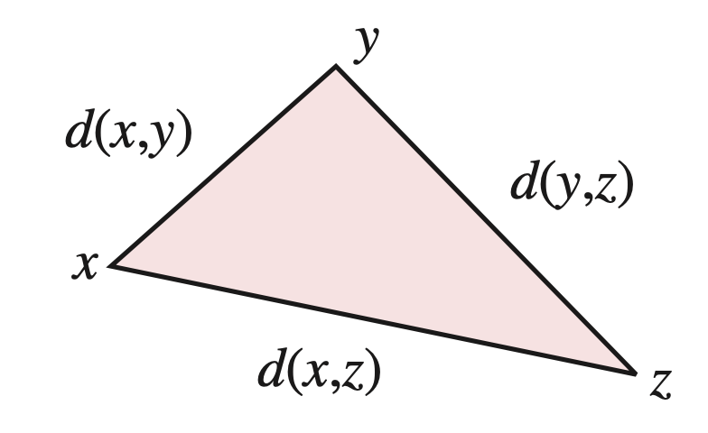
Metric spaces
A point-set S is a metric space if there is a distance function d, which takes ordered pairs (s,t) of elements of S and returns a distance that satisfies the following conditions
For each pair s, t in S, d(s,t) > 0 if s and t are distinct points and d(s,t) = 0 if s and t are identical (indiscernibility)
For each pair s, t in S, the distance from s to t is equal to the distance from t to s, d(s,t) = d(t,s) (symmetry)
For each triple s, t, u in S, the sum of the distances from s to t and from t to u is always at least as large as the distance from s to u (triangle inequality)

Slide 53
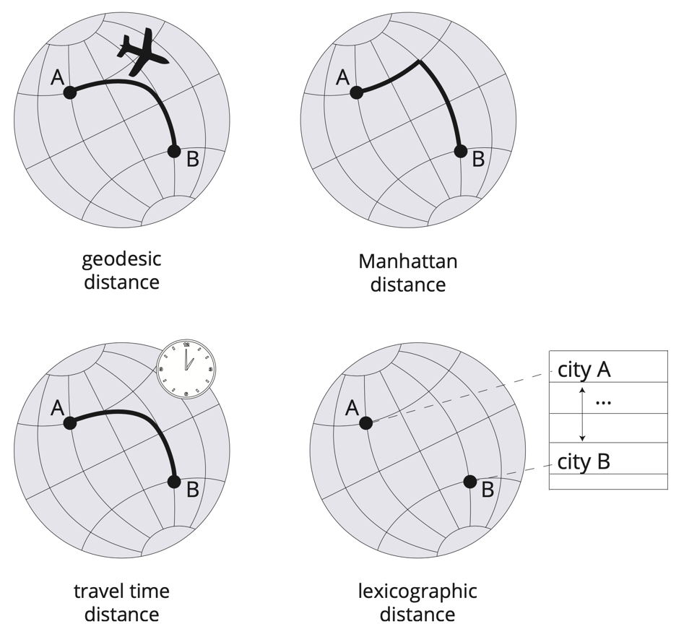
Metrics on the globe
metric
metric
quasimetric
metric

Slide 54
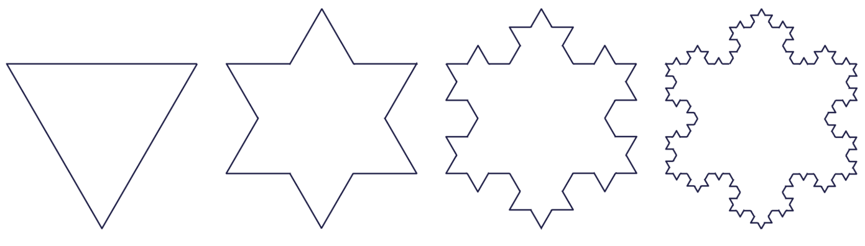
Fractal geometry
Scale dependence: appearance and characteristics of many geographic and natural phenomena depend on the scale at which they are observed
Straight lines and smooth curves of Euclidean geometry are not well suited to modeling self-similarity and scale dependence
Fractals: self-similar across all scales
Defined recursively, rather than by describing their shape directly

Slide 55
Fractal dimension
Self-affine fractals: constructed using affine transformations within the generator, so rotations, reflections, and shears can be used in addition to scaling
Fractal dimension: an indicator of shape complexity
Lies somewhere between the Euclidean dimensions of the shape and its embedding space
A shape with a high fractal dimension is complex enough to nearly fill its embedding space (space filling)

Slide 56
Acknowledgments
Book website: http://gisacp.duckham.org All images: GIS: A Computing Perspective 3e, unless otherwise stated
Artwork: Lou Bloomer

